Slide 1
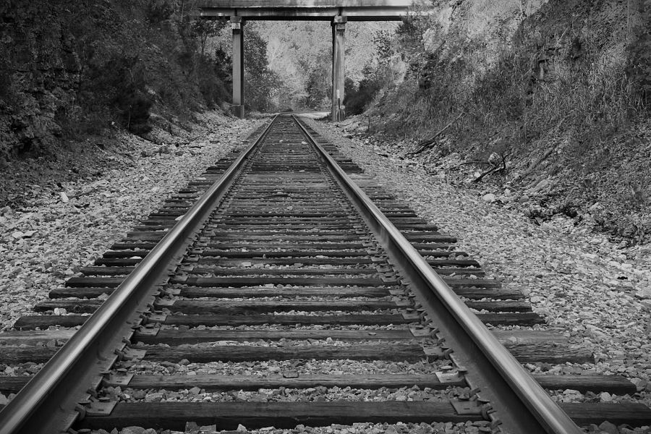
CAPSTONE I – Final Presentation – FALL 2023
BRAIN BALLAST SENSOR
DREW STULL, BRAEDEN MORGAN, ANDREW MURPHY, CLAYTON WARSTLER, FERNANDA CAERO
PROJECT SPONSORS: DR. MICHELLE LEE BARRY, MR. BEN DAVIS
Notes:
Fernanda

Slide 2
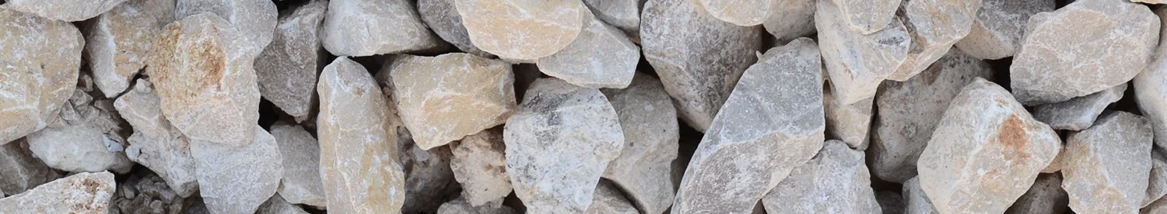
INTRODUCTION
Railroads play a big role in today's modern infrastructure. They are a large contributor to economic activities and in connecting our country with supplies. There are many problems involving railroad maintenance, but one of the biggest challenges involves the ballast beneath the tracks.
Our project addresses a critical issue involving “railroad ballast” and the maintenance of railroad tracks. Ballast is the small rocks that sit below and support railroad tracks. Over time the pressure applied from the trains and deterioration from the environment wear this ballast down.
Notes:
Fernanda

Slide 3
Problem Statement and Understandable objective
Problem Statement
OBJECTIVES
Our objective is to modify an existing wireless water pressure a device to:
be placed within the inner ballast
detect core water pressure and transmit the data wirelessly from within the ballast.
Detect when the device has been moved through an accelerometer
We will accomplish by taking an existing Transducers Direct Cirrussense TDWLB0050034 Wireless pressure transducer’ pressure sensor and making improvements on it such as: adding additional hardware like the BOSCH BMA400 accelerometer, redesigning the housing of the device, and extracting the voltage readings from the device rather than going through Transducers Direct proprietary ‘Pressure pro app’.
Overtime pressure from trains and environmental factors wear down the ballast until it has become fouled.
One of the leading causes of fouled ballast is the build up of water pressure within the interior of the rock.
There is currently is not an easy way to detect this build up of pressure.
obj
Notes:
Drew

Slide 4
Potential Impact and topic difficulty
POTENTIAL IMPACT
Topic Difficulty
Increase railroad safety by providing important data so that railroad maintenance crews can tell the quality of the ballast without having to dig anything up.
Decrease the spending needed by the railroad industry to monitor the quality of the ballast. Which will benefit both the railroad industry and public safety.
Device has the potential to be used in other soil maintenance-based fields like golf course upkeep.
Discovering how to extract the voltage readings from the device via Bluetooth rather than using a proprietary app.
Adding additional hardware to an already built out system to add additional functionality to the device, including accelerometer data.
Make sure that the additional hardware components data can be sent through the same Bluetooth channel.
Building a small housing that will fit all components.
obj
Notes:
Braeden

Slide 5
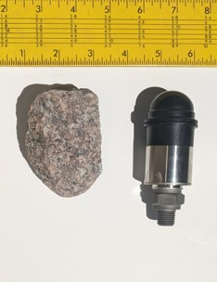
BACKGROUND AND RELATED WORK
There currently is not a small device that can detect core water pressures from within the ballast. There are larger devices that scan the ballast from the exterior but are often costly. There’s been a variety of research done about the deterioration of railroad ballast, but none have attempted to create an internal device to detect this fouled ballast.
Our device will make use of the correlation between the buildup of water pressure within the ballast and the deterioration of the ballast itself.
Hai Huang’s ‘Laboratory Characterization of Fouled Railroad Ballast Behavior’ research used a ‘large direct sheer device’ to study different ballast materials and how they fouled in different conditions. Dr. Barry’s lab has a similar device used to apply direct sheer force to ballast samples, called ‘LS-DSS’. They also used a large direct sheer device to measure the strength and deformation of ballast based on different fouling material. Ballast fouling can occur with a wide variety of different material, while our project focuses on the buildup of water pressure specifically.
Typical Ballast Particle
BLE Sensor
Our Brain Ballast sensor, will stand out by creating a device that will use wireless transmission of data, internal power, additional device movement data through additional hardware, and a new casing for the device.
Notes:
Clayton

Slide 6
TASKS
1. Modify TDWLDB0050034 to extract voltage readings from device and send them via Bluetooth.
2. Test and add the BOSCH BMA400 accelerometer to get movement data.
3. Get the BMA400 to transmit data through the same Bluetooth connection already in place on the device.
4. Use CAD tools to redesign the housing of the device to be more organically shaped.
5. Perform testing in laboratory setting to prove that the implementation was successful
6. Split the group into two teams and have one groups focus be on improving the battery life of the device.
7. The other group will focus on discovering how to improve the transmission of data from the device to a smart phone.
8. Implement any findings that the team discovers.
9. Perform more testing on the device and finalize the Brain Ballast Sensor.
STEP 1
STEP 2
STEP 3
STEP 4
STEP 5
Modify
Implement new hardware
Redesign Housing
TEST
Research additional improvements and finalize
Notes:
Andrew

Slide 7
Use Cases Of the Sensor
The specific use case that we are designing the Brain Ballast Sensor for is to be placed within the interior of railroad ballast. The sensor will then detect the build up of water pressure within the ballast which correlates to the ballast becoming fouled.
The device will transmit its data wirelessly which will allow the user of the device to easily collect the water pressure and accelerometer data easily without having to dig the device out of the soil it sits in.
With the new hardware components that we intend to add to the device, the sensor will now be able to detect when it has shifted from its original position. This will be another indicator of changes within the ballast.
Since the device is a small modular form factor it will allow for multiple devices to be placed throughout large sections of ballast to get a wide range of data.
Although the device is originally designed to be placed within railroad ballast, with modifications to the water inlet on the device it could then be used in a variety of soil conditions.
One example of this could be to place a modified sensor beneath the greens of a golf course hole to ensure that the greens have the proper amount of water in their soil.
Notes:
Drew

Slide 8
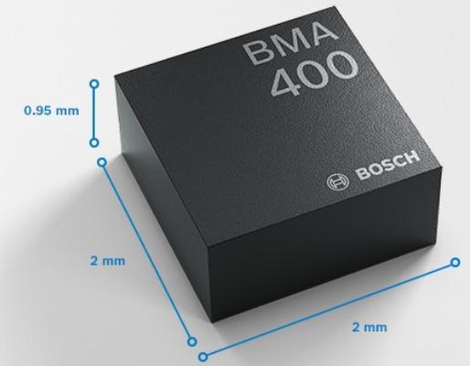
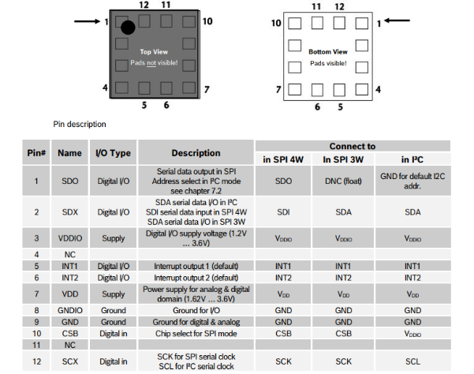
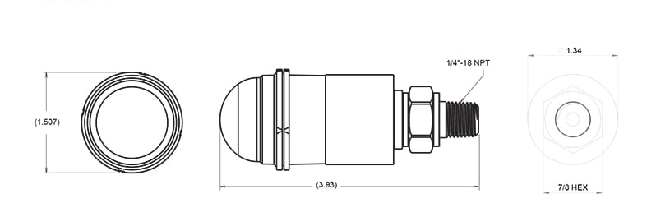
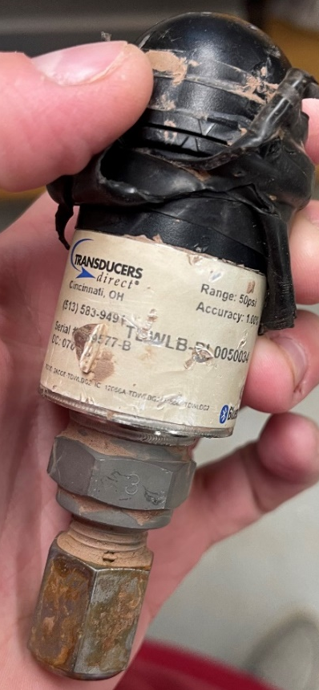
Brain Ballast Sensor Architecture
The Brain Ballast Sensor overall goal is to be able detect core water pressures from within the center of railroad ballast and transmit this collected data wirelessly. Our plan is to make modifications to a currently existing device already on the market. The device we plan to make modifications to is the Transducers Direct Cirrussense TDWLB0050034 Wireless pressure transducer [26].
The main piece of hardware we intend to add is a BOSCH accelerometer sensor called the BMA400. This piece of hardware will allow us to detect movements from the Brain Ballast Sensor which can further indicate changes in the railroad ballast [5].
Current TDWELB0050034 device
BOSCH BMA400 Accelerometer
BOSCH BMA400 Accelerometer pin layout
Notes:
Drew

Slide 9
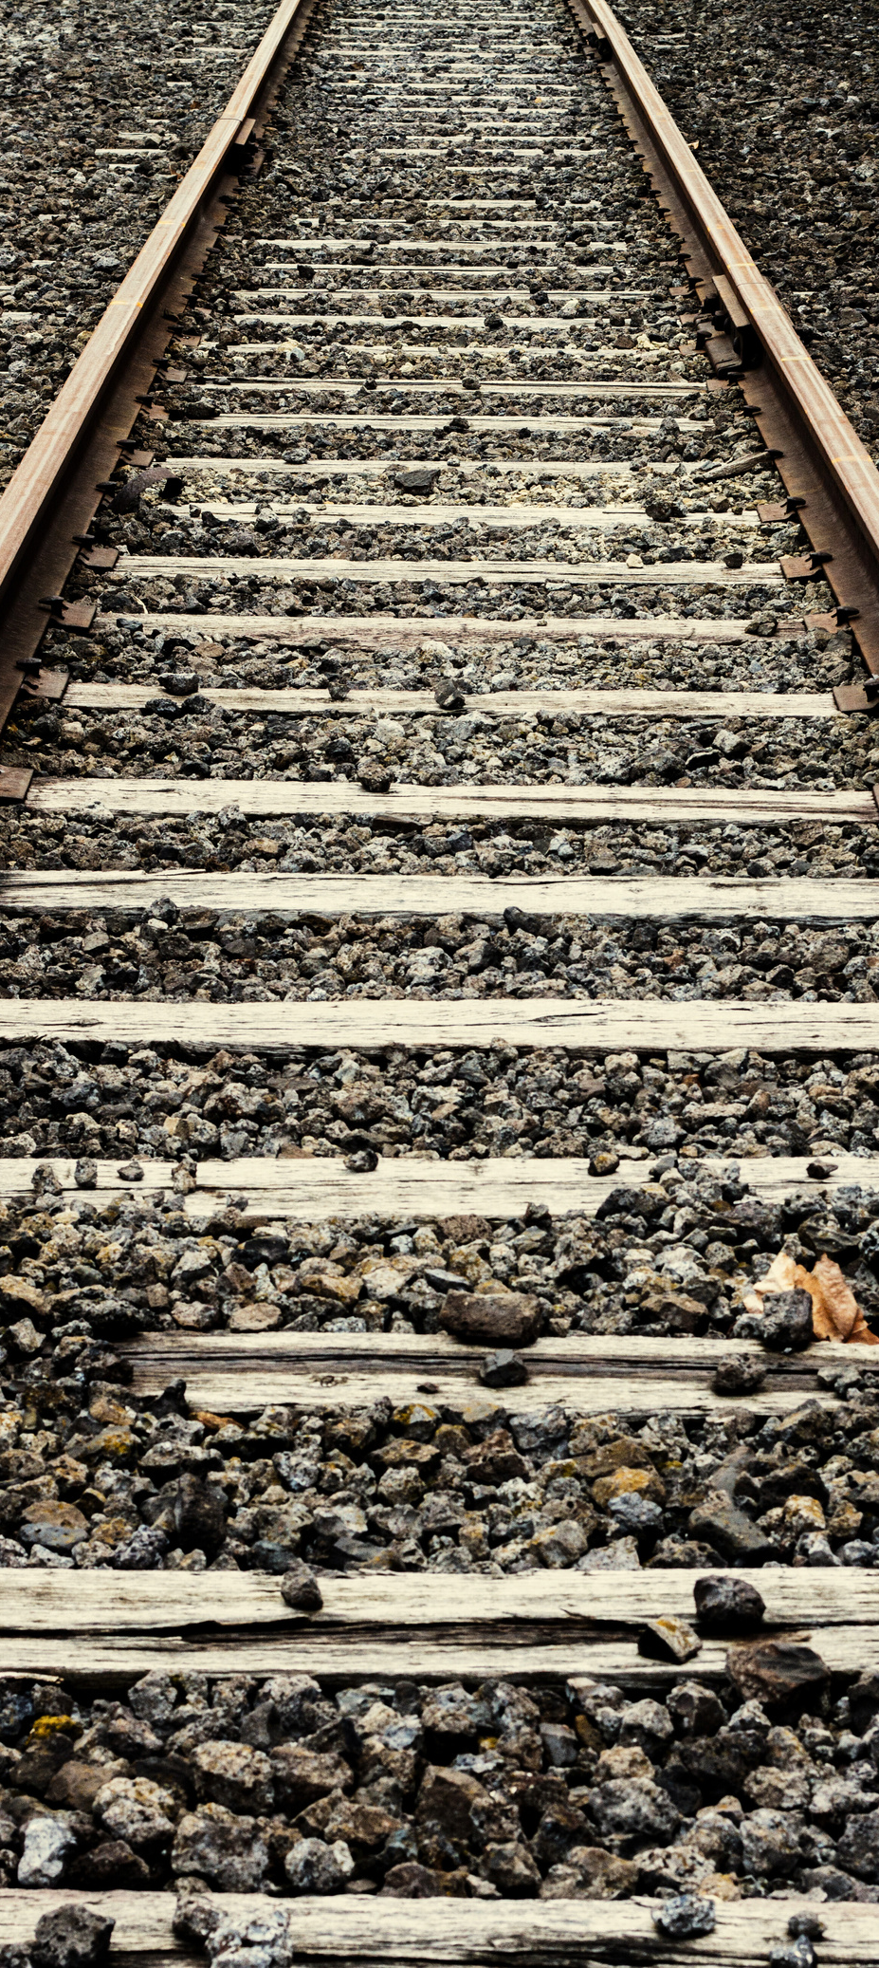
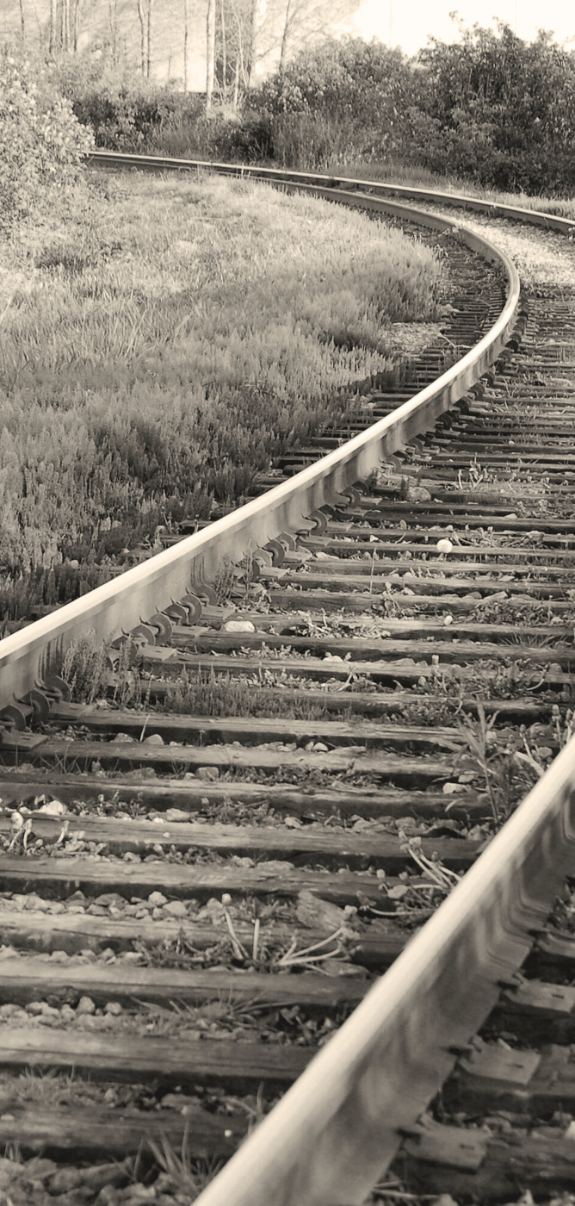
Thank you

Slide 10
References
Acceleration sensor BMA400, https://www.bosch-sensortec.com/products/motion-sensors/accelerometers/bma400/
Ballast Contamination Mechanisms, https://encyclopedia.pub/entry/6416
Bluetooth Tool Module, https://www.boschtools.com/us/en/boschtools-ocs/drill-driver-attachments-gcy42-203552-p/
Bluetooth vs. Wi-Fi, https://www.diffen.com/difference/Bluetooth_vs_Wifi
BMA400, https://www.bosch-sensortec.com/media/boschsensortec/downloads/datasheets/bst-bma400-ds000.pdf
Brain Ballast Capstone Barry, https://uark.app.box.com/v/CSCECapstoneProjects/file/1292164566100
CirrusSense™ TDWLB, TDWLB-DL & TDWLB-LC iOS Application User Guide, https://transducersdirect.com/wp-content/uploads/2023/07/TDWLB-iOS-App-UserGuide-5.23.pdf
CSCE Faculty Directory, https://computer-science-and-computer-engineering.uark.edu/directory/index/uid/patitz/name/Matthew-Patitz/
CVEG Faculty Directory, https://civil-engineering.uark.edu/directory/index/uid/mlbernha/name/Michelle+Lee+Barry/
Federal Railroad Administration Office of Research, Development, and Technology, https://imlive.s3.amazonaws.com/Federal%20Government/ID83238750918858580289819349035833909191/BAA%202021%20Appendix%20C%20Amended%204_16_2021.pdf
How Bluetooth Works, https://electronics.howstuffworks.com/bluetooth.htm
Huang, H., Tutumluer, E., & Dombrow, W. (2009). Laboratory Characterization of Fouled Railroad Ballast Behavior. Transportation Research Record, 2117(1), 93-101. https://doi.org/10.3141/2117-12
Identification of Behavioral Models for Railway Turnouts Monitoring, https://www.researchgate.net/publication/336552261_Identification_of_Behavioural_Models_for_Railway_Turnouts_Monitoring
Introduction about BMA400 Auto Wakeup and Auto Low Power, https://community.bosch-sensortec.com/t5/Knowledge-base/Introduction-about-BMA400-Auto-Wakeup-and-Auto-Low-Power/ta-p/8863
Investigation of Ballast Degradation and Fouling Trends using Image Analysis, https://railtec.illinois.edu/wp/wp-content/uploads/2019/01/Moaveni%20et%20al_2014%20Railways%202014.pdf
Laboratory Characterization of Fouled Railroad Ballast Behavior, https://railtec.illinois.edu/wp/wp-content/uploads/pdf-archive/Huang-et-al-2009_1.pdf
Michelle L. Bernhardt-Barry, Kathy Scheibel, Richard Coffman, Robert T. Banister, “Development and Assessment of a Pore Water Pressure and Matric Suction Sensor: Laboratory Strength Testing and Field Substructure Monitoring”, Prepared in Response to: FRA BAA-2021 Topic FRA-TR-012 – Substructure Pore Water Pressure and Matric Suction Sensor Development and Assessment, 2021
(Pre project BMA400, https://community.bosch-sensortec.com/t5/MEMS-sensors-forum/Pre-project-BMA400/td-p/14102
Pressure sensors for different media types, https://www.avnet.com/wps/portal/abacus/solutions/technologies/sensors/pressure-sensors/media-types/water/
Railroad Ballast, https://www.mrtaggregates.com/wp-content/uploads/2015/11/IMGP3225-500x480.jpg
Railway ballast performance: Recent advances in the understanding of geometry, distribution and degradation, https://www.sciencedirect.com/science/article/pii/S2214391223001150
Troubleshooting Wireless Coexistence Problems in the Industrial Internet of Things, https://www.researchgate.net/publication/316674860_Troubleshooting_Wireless_Coexistence_Problems_in_the_Industrial_Internet_of_Things
Trung Ngo, Buddhima Indraratna, “Analysis of Deformation and Degradation of Fouled Ballast: Experimental Testing and DEM Modeling”, Internation Journal of Geomechanics, 2020
UV or EC? Choosing the right ballast water management system for the environment – and your business profile, https://www.alfalaval.com/microsites/pureballast/selecting/uv-ec/uv-ec-environment/?utm_source=google&utm_medium=cpc&utm_campaign=environment_uv_ec&utm_source=google&utm_medium=cpc&utm_campaign=global_global_md_wwf_a_pureballast-uv-ec_gcpc_environment-2023&utm_content=environmentsearchad&utm_term=Ballastwatermanagement&utm_matchtype=broad&gad=1&gclid=CjwKCAjwysipBhBXEiwApJOcu5FdxR1mf0414_jU3unH1S20vjQNWX-1ChPpfu2rkOGeJAGnrvfDqhoCZHoQAvD_BwE
WHY ARE THERE CRUSHED STONES ALONGSIDE RAIL TRACKS, HTTP://WWW.RAILROADFASTENINGS.COM/BLOG/FUNCTIONS-OF-TRACK-BALLAST.HTML
WIRELESS PRESSURE TRANDUSERS, https://transducersdirect.com/products/pressure-transducers/wireless-pressure-transducers/cirrussense-tdwlb-wireless-pressure-transducer/

